Slide 1

Basic Details of the Team and Problem Statement
HackToFuture-2024
In Association with
The Institution of Engineers (India)
IEI Local Centre, Belagavi
Domain : CYBERSECURITY
PS Code: CS02
Problem Statement Title: Innovative,Easy to use and Secured Online Banking System for Differently-Abled(Divyaang)
Team Name: Avengers
Team Leader Name: Adesh Kumbar
Table Code Assigned: 2.1
Institute Name: KLE Institute Of Technology, Hubballi

Slide 2



Empowering Accessibility: Introducing Our Innovative Online Banking System
Our online banking platform is designed with differently abled (divyaang) individuals in mind, offering a secure and user-friendly digital experience. We are committed to making banking accessible and inclusive for all.

Slide 3
Secure and User-Friendly Design
Accessibility Features
Intuitive Interface
Our platform incorporates assistive technologies, such as voice commands to ensure a seamless experience for users with diverse abilities.
The clean and uncluttered design of our online banking system makes it easy to navigate and perform tasks, even for first-time users.

Slide 4
Benefits of Our Online Banking Solution
1
Convenient
2
Empowering
Access your accounts and manage your finances from the comfort of your own home or on the go.
Take control of your financial well-being with our comprehensive suite of tools and resources.
3
Secure
4
Inclusive
Rest assured that your personal and financial information is protected with our robust security measures.
Our platform is designed to cater to the diverse needs of our differently abled (divyaang) customers.

Slide 5

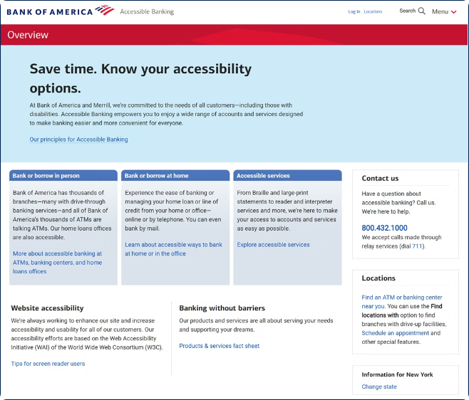
Key Features of Our Secure and User-Friendly Digital Platform
1
Assistive Technologies
Voice commands for seamless accessibility.
2
Customizable Settings
Personalize your experience with adjustable font sizes, contrast, and other accessibility options.
3
Secure Transactions
Bank with confidence, knowing your sensitive information is protected by industry-leading security protocols.

Slide 6
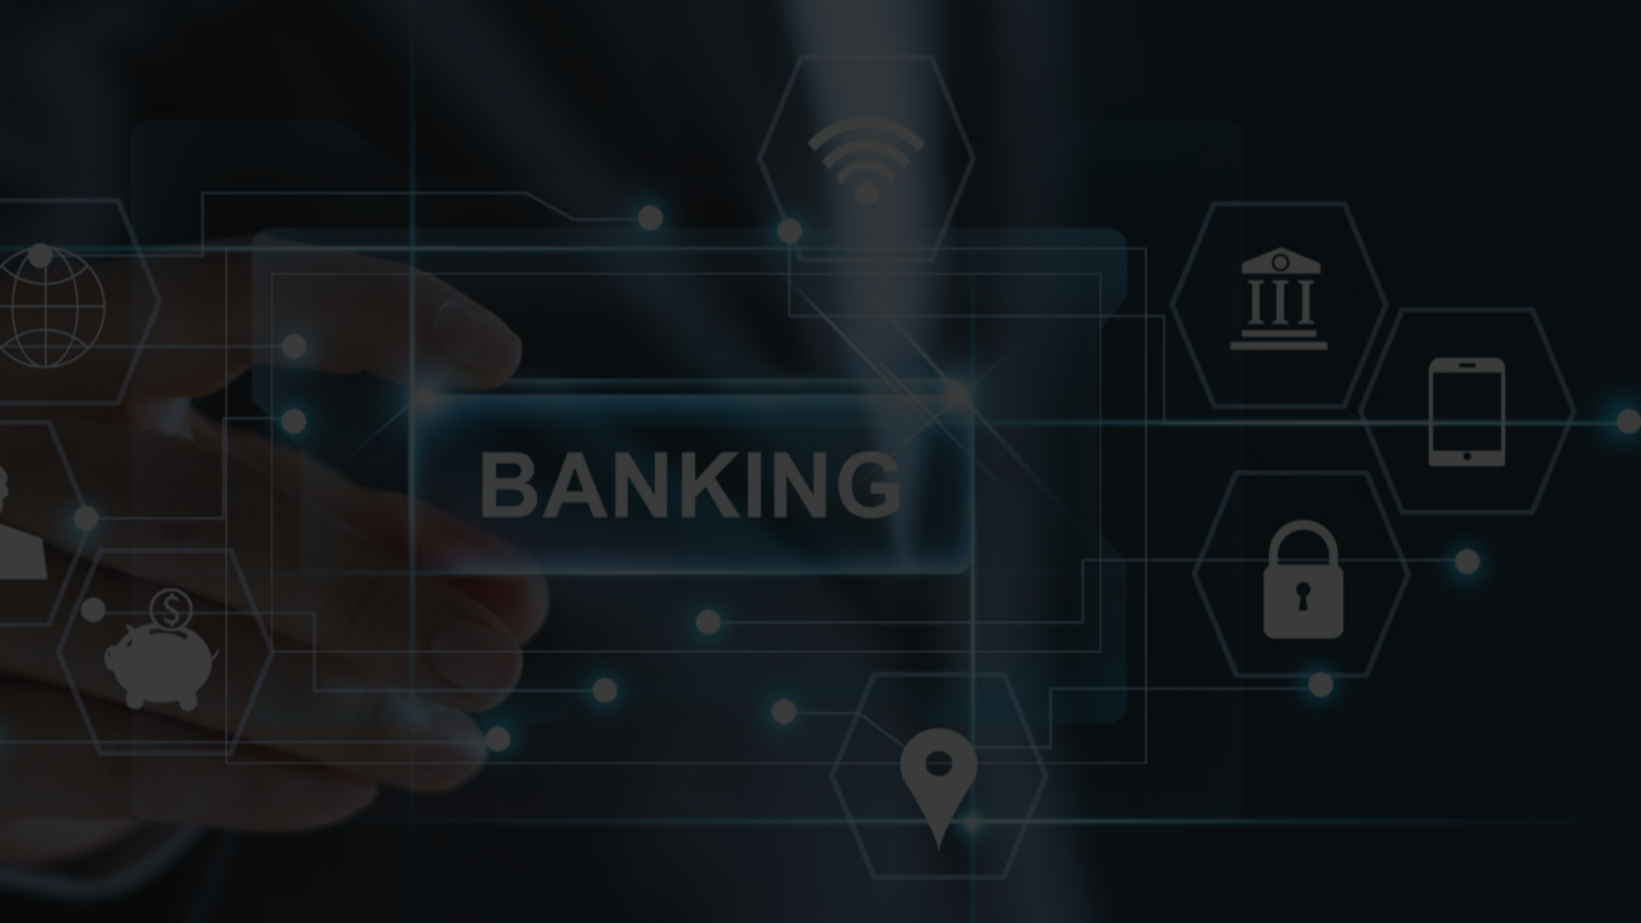
Unlocking Financial Independence: Join Us Today
Empowered Banking
Inclusive Access
Secure Your Future
Take control of your finances and join our growing community of differently abled (divyaang) customers who trust our platform.
Experiencethe convenience and security of our innovative online banking system, designed to meet your unique needs.
Enroll now and unlock the power of our digital banking solutions to achieve your financial goals.

Slide 7
Output Screensnaps

Slide 8
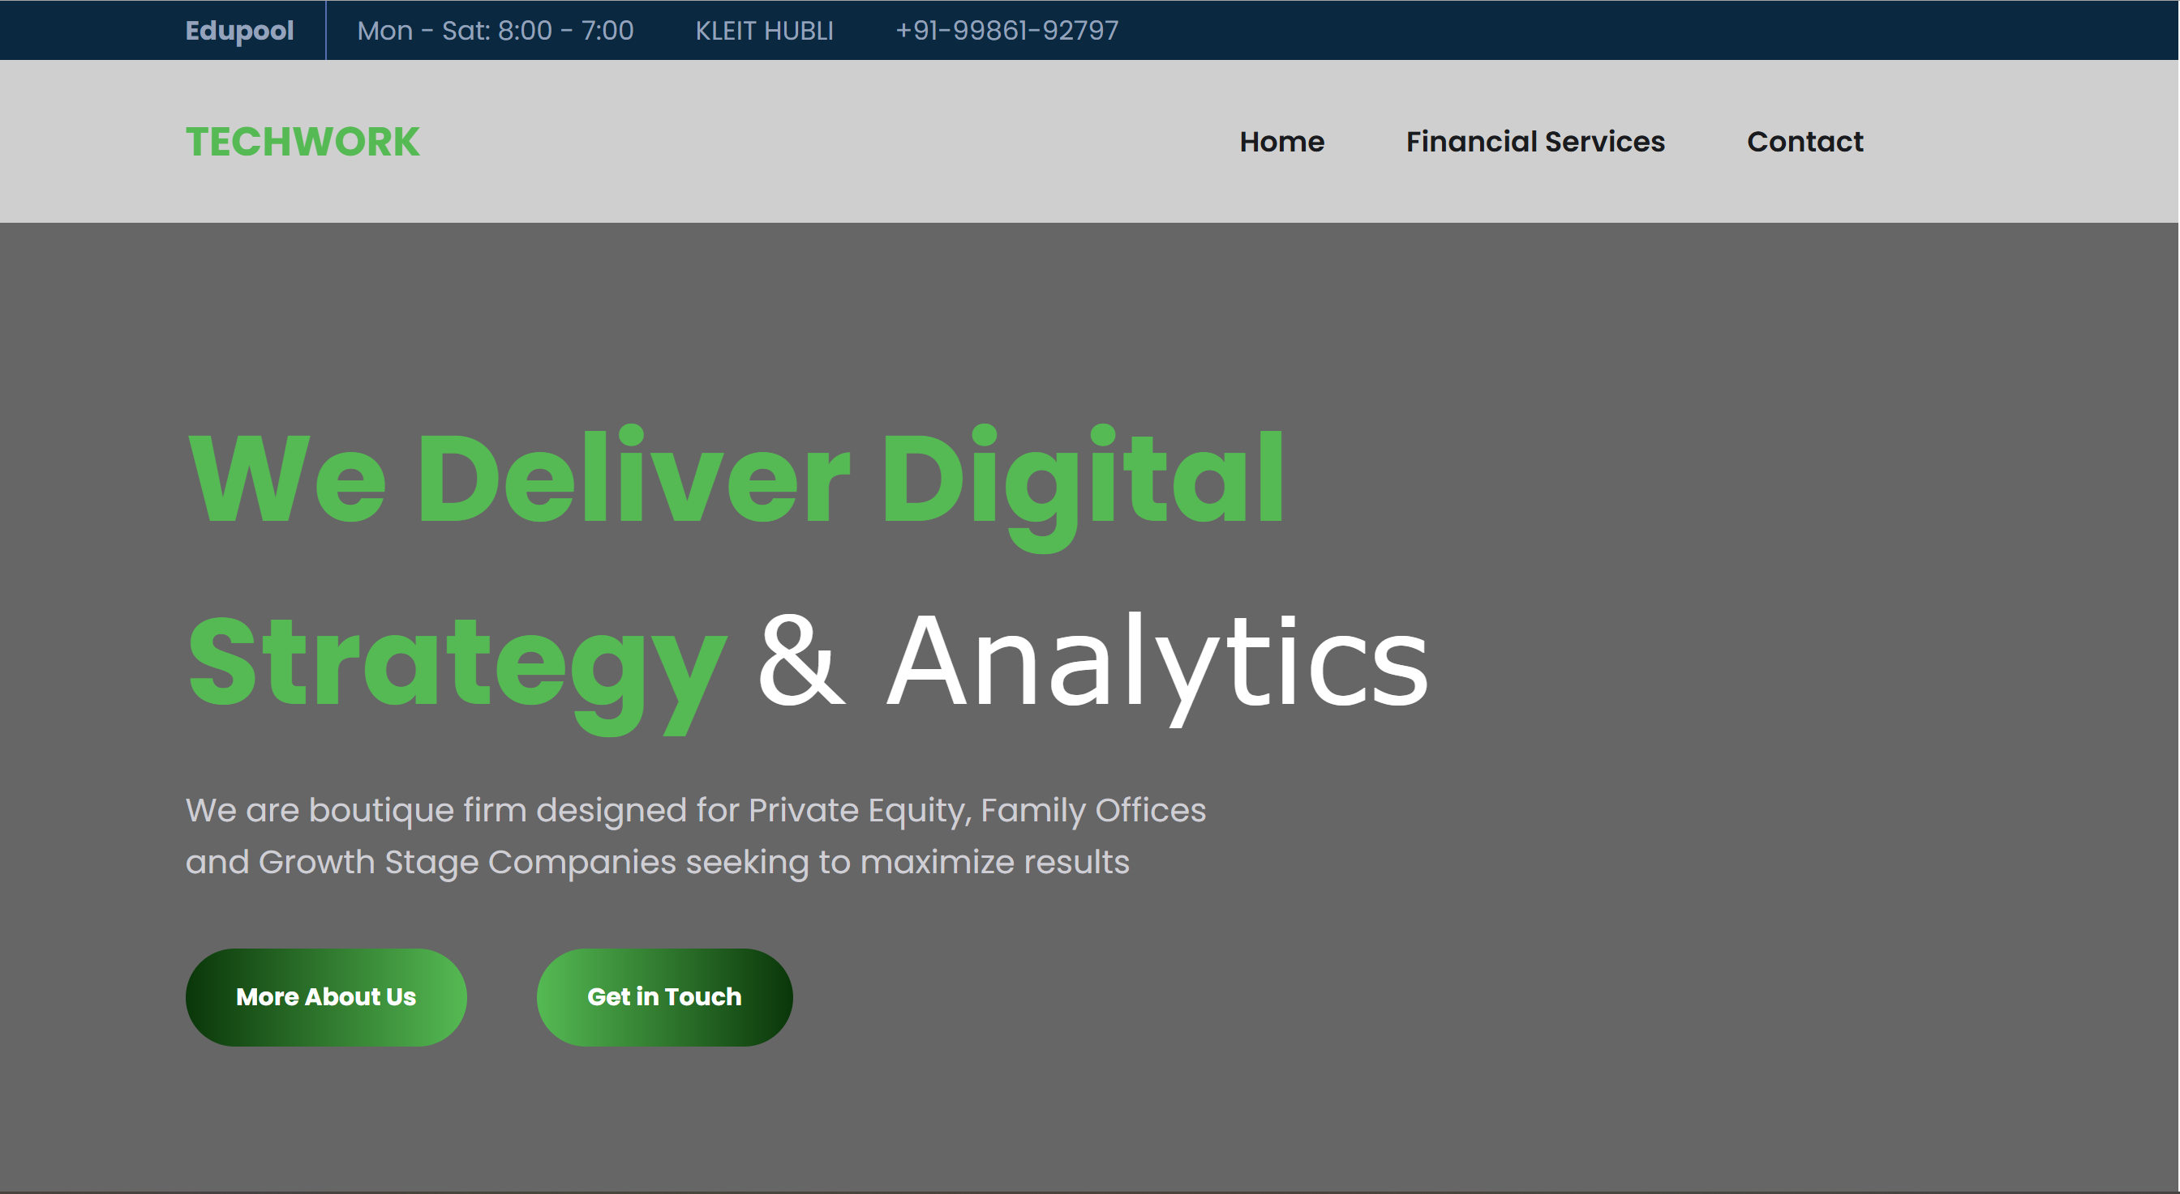

Slide 9
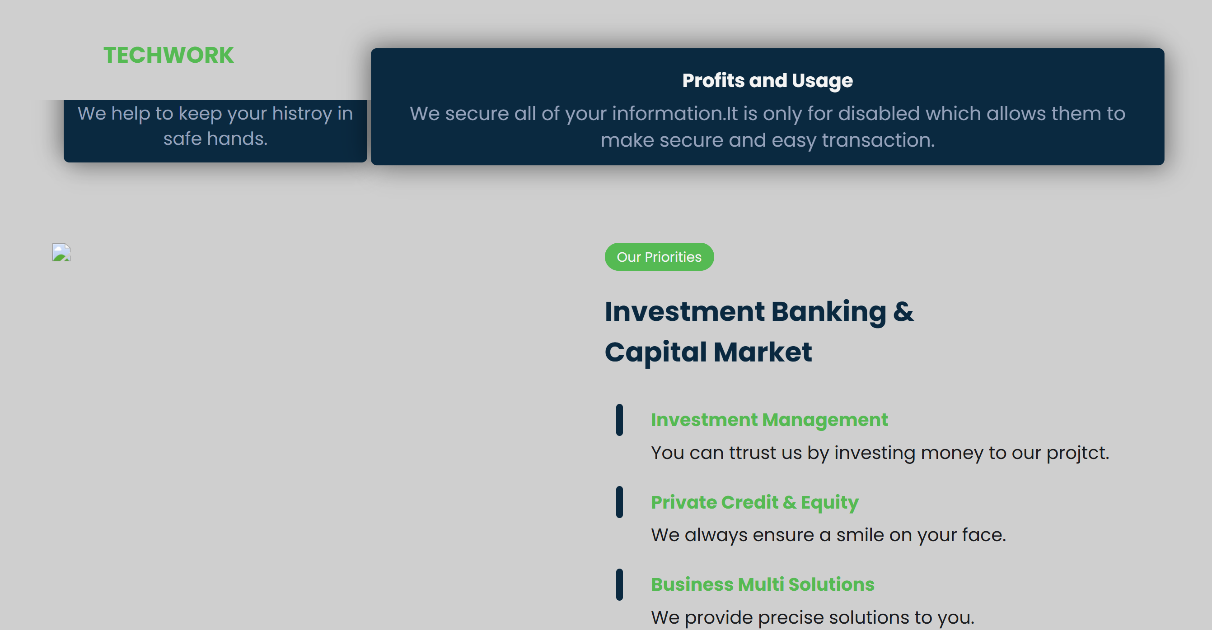

Slide 10


Slide 11
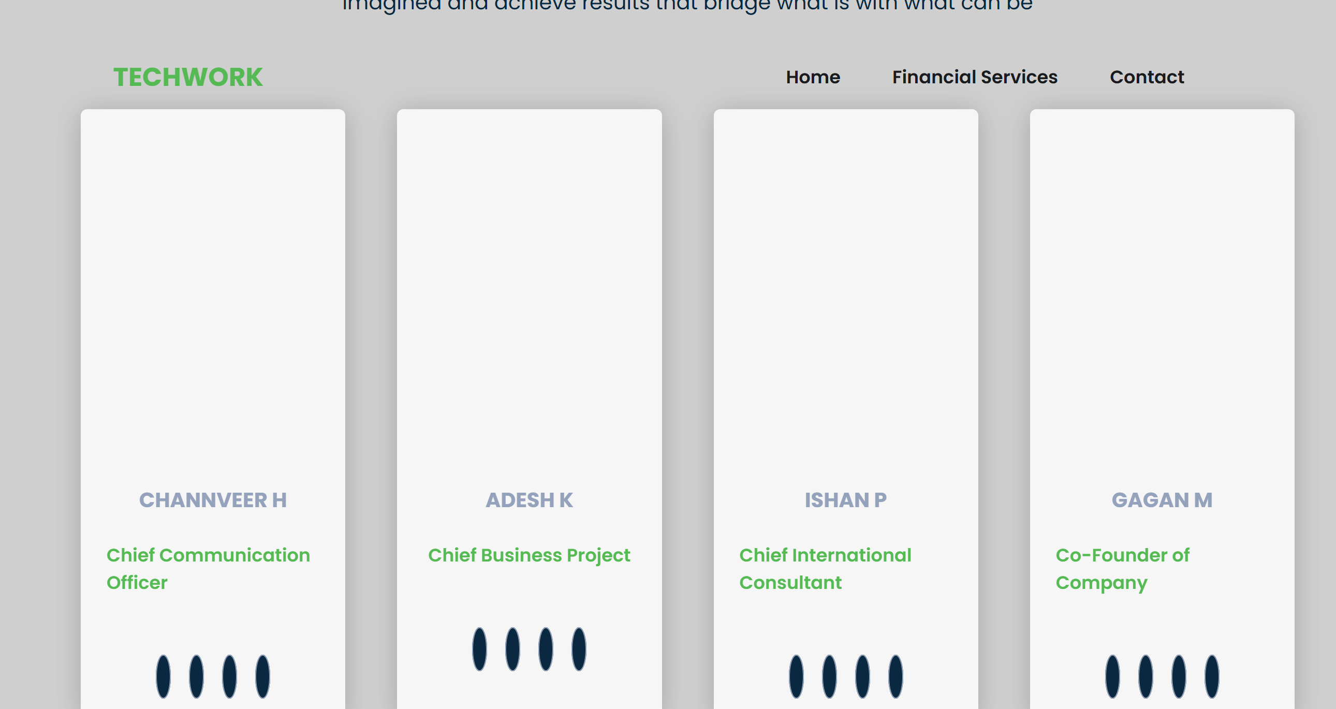

Slide 12
